Slide 1
Mesh Current Method
The second method of circuit analysis employs mesh currents as the independent variables.
To write the appropriate number of independent equations, using mesh currents as the independent variables.

Slide 2
Mesh Current Method
Subsequent application of Kirchhoff’s voltage law (KVL) around each MESH provides the desired system of equations.
In the mesh current method, a current flowing through a resistor in a specified direction defines the polarity of the voltage across the resistor

Slide 3
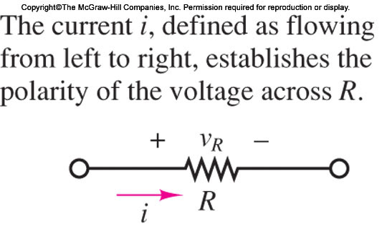
Mesh Current Method
In the mesh current method, a current flowing through a resistor in a specified direction defines the polarity of the voltage across the resistor

Slide 4
Mesh Current Method
The sum of the voltages around a closed circuit must equal zero, by KVL.
Once a convention is established regarding the direction of current flow around a mesh, simple application of KVL provides the desired equation.

Slide 5
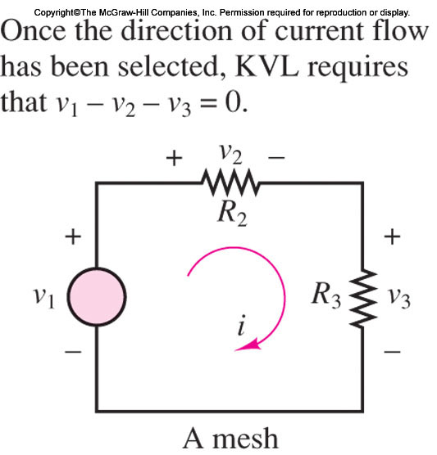
Mesh Current Method
The sum of the voltages around a closed circuit must equal zero, by KVL.

Slide 6
Mesh Current Method
The number of equations by this technique is equal to the number of meshes in the circuit.
# of equations = # of meshes
All branch currents and voltages may subsequently be obtained from the mesh currents

Slide 7
Mesh Current Method
Since meshes are easily identified in a circuit, this method provides a very efficient and systematic procedure for the analysis of electric circuits.
In mesh analysis, to be consistent in choosing the direction of current flow.

Slide 8
Mesh Current Method
To avoid confusion in writing the circuit equations, unknown mesh currents are defined exclusively clockwise when we are using this method.

Slide 9
Mesh Current Method
As long as signs are assigned consistently, an arbitrary direction may be assumed for any current in a circuit;
If the resulting numerical answer for the current is negative, then the chosen reference direction is opposite to the direction of actual current flow.

Slide 10
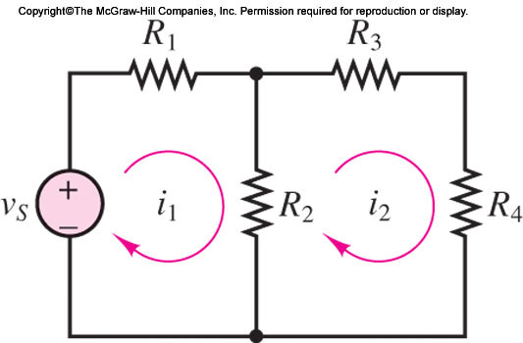
Mesh Current Method
As long as signs are assigned consistently, an arbitrary direction may be assumed for any current in a circuit;

Slide 11
Mesh Current Method
This circuit is used to generate two equations in the two unknowns, the mesh currents i1 and i2.
It is instructive to first consider each mesh by itself. Beginning with mesh 1,
Note that the voltages around the mesh have been assigned…

Slide 12
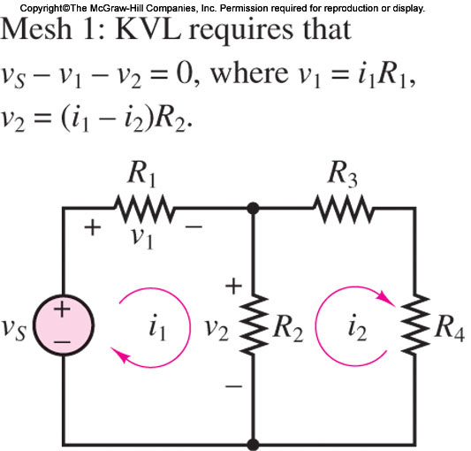
Mesh Current Method
Note that the voltages around the mesh have been assigned according to the direction of the mesh current i1.

Slide 13
Mesh Current Method
Recall that as long as signs are assigned consistently, an arbitrary direction may be assumed for any current in a circuit;
If the resulting numerical answer for the current is negative, then the chosen reference direction is opposite to the direction of actual current flow.

Slide 14
Mesh Current Method
One need NOT be concerned about the actual direction of current flow in mesh analysis,
Once the directions of the mesh currents have been assigned. The correct solution will result, eventually…

Slide 15
Mesh Current Method
One need NOT be concerned about the actual direction of current flow in mesh analysis,
Once the directions of the mesh currents have been assigned. The correct solution will result, eventually…

Slide 16
Mesh Current Method –Mesh 1
While mesh current i1 is equal to the current flowing through resistor R1 (and is therefore also the branch current through R1), However, it is NOT equal to the current through R2.

Slide 17


Mesh Current Method
The branch current through R2 is the difference between the two mesh currents i1 − i2.
As the polarity of voltage v2 has already been assigned, it follows that the voltage v2 is given by

Slide 18

Mesh Current Method – Mesh 2
Voltage assignment around the Mesh 2, following the clockwise direction of mesh current i2.
The mesh current i2 is also the branch current through resistors R3 and R4; however, the current through the resistor that is shared by the two meshes, denoted by R2, is now equal to i2 − i1; the voltage across this resistor is:

Slide 19
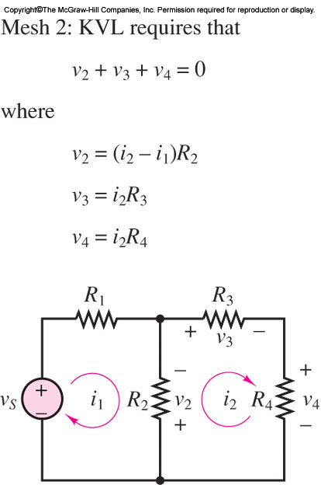
Mesh Current Method – Mesh 2
the complete expression for mesh 2 is

Slide 20

Mesh Current Method – Mesh 2
Combining the equations for the two meshes, we obtain the following system of equations:
Mesh 1
Mesh 2

Slide 21
Mesh Current Method
Mesh 1
Mesh 2

Slide 22
Mesh Current Method
These equations may be solved simultaneously to obtain the desired solution, namely, the Mesh current i1 and Mesh current i2.

Slide 23
Mesh Current Method
Assignment of currents and voltages around mesh 1
Assignment of currents and voltages around mesh 2

Slide 24
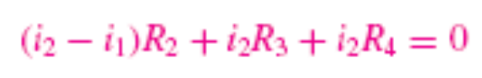
Mesh Current Method
The complete expression for mesh 1 is
The complete expression for mesh 2 is

Slide 25
MESH CURRENT ANALYSIS METHOD
MESH CURRENT ANALYSIS METHOD
1. Define each mesh current consistently. Unknown mesh currents will be always defined in the clockwise direction; known mesh currents (i.e., when a current source is present) will always be defined in the direction of the current source.
2. In a circuit with n meshes and m current sources, n − m independent equations will result. The unknown mesh currents are the n − m independent variables.
3. Apply KVL to each mesh containing an unknown mesh current, expressing each voltage in terms of one or more mesh currents.
4. Solve the linear system of n − m unknowns.

Slide 26
How to learn ELEE2500 effectively
How to study ELEE2500 effectively?
By examples

Slide 27
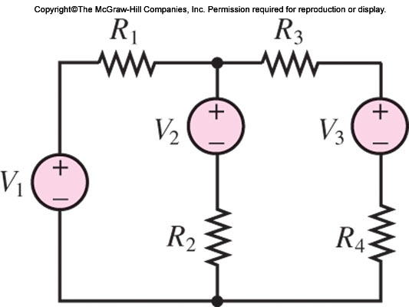
MESH CURRENT ANALYSIS METHOD
Find the mesh currents in the following circuit by Mesh Current Analysis Method

Slide 28
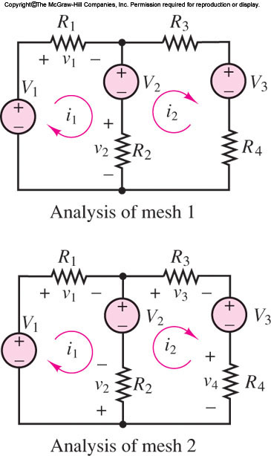


MESH CURRENT ANALYSIS METHOD
Find the mesh currents in the following circuit by Mesh Current Analysis Method

Slide 29
References
Giorgio Rizzoni, “Fundamentals of Electrical Engineering”, McGraw- Hill Education, 2009. ISBN. 978-0-07-338037-7
Peyton Z. Peebles (Author), Tayeb A. Giuma, Principles of Electrical Engineering (Mcgraw Hill Series in Electrical and Computer Engineering), Mcgraw-Hill College, 1991.
Allan R. Hambley, Electrical Engineering: Principles and Applications, Prentice Hall, ISBN-0132130068, 9780132130066, 2011.

